Slide 1
Walking Towards Longer Sleep
Joe D'Agostino
Data Exploration 5101 - Fall 2025

Slide 2
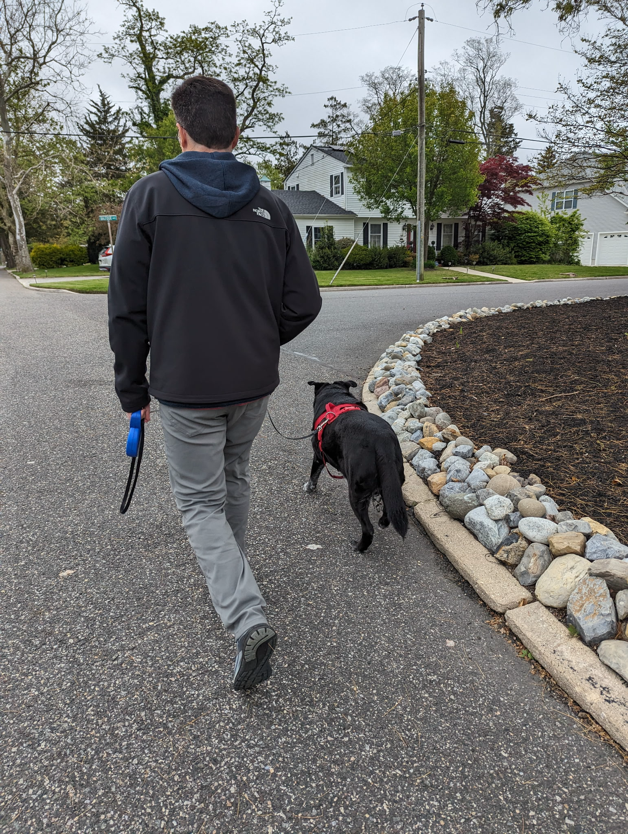
Physical Activity is Good

Slide 3
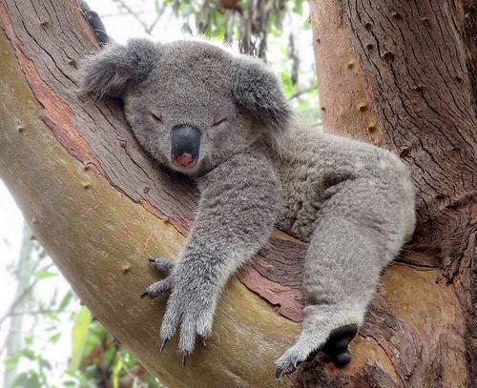
Sleep is Good

Slide 4
Does physical activity during a day correlate to length of sleep that night?

Slide 5
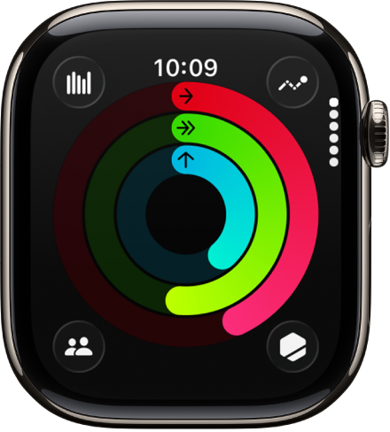
Data
Apple Health App (2.47 GB XML)​
Apple Watch sensors

Slide 6
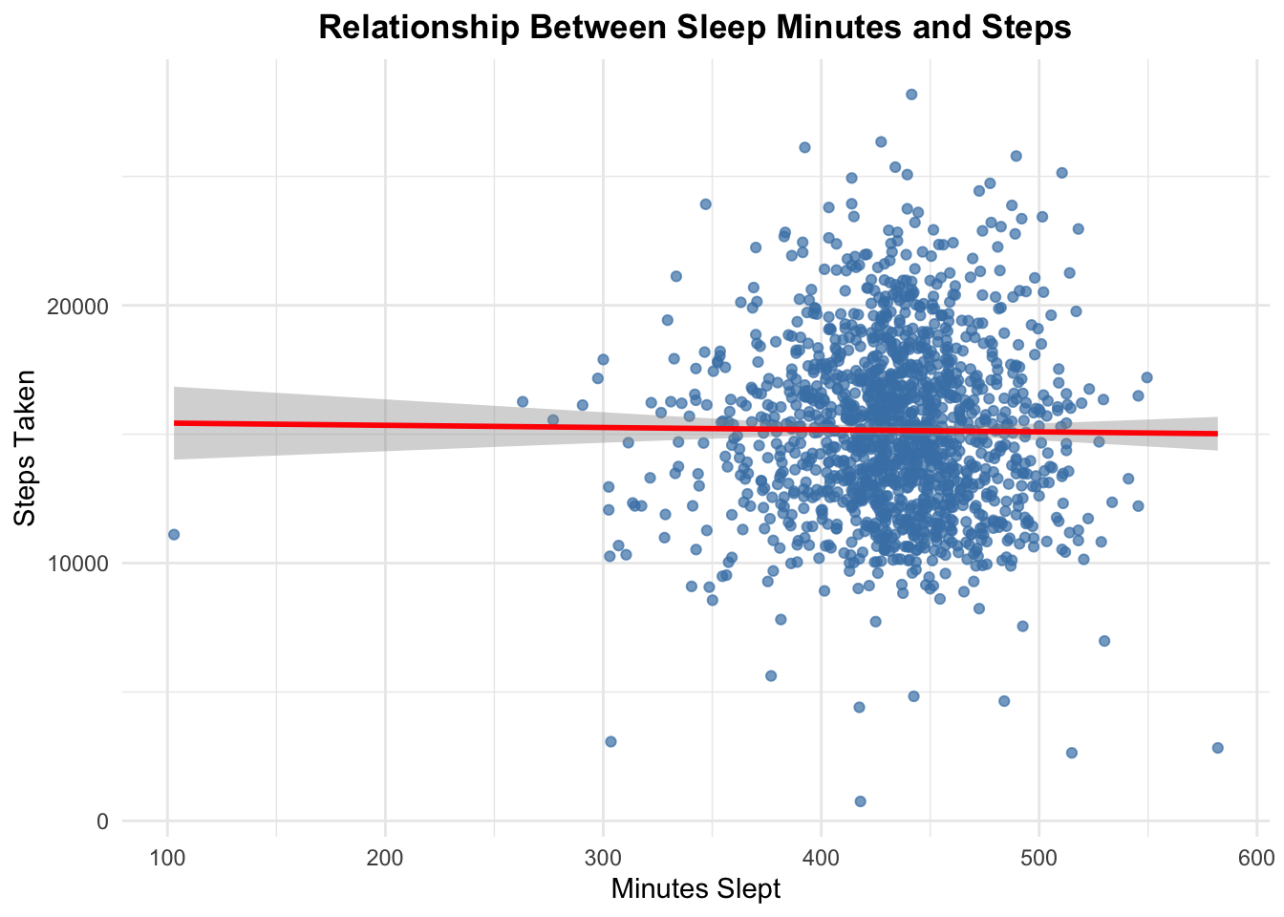
p = 0.6938

Slide 7
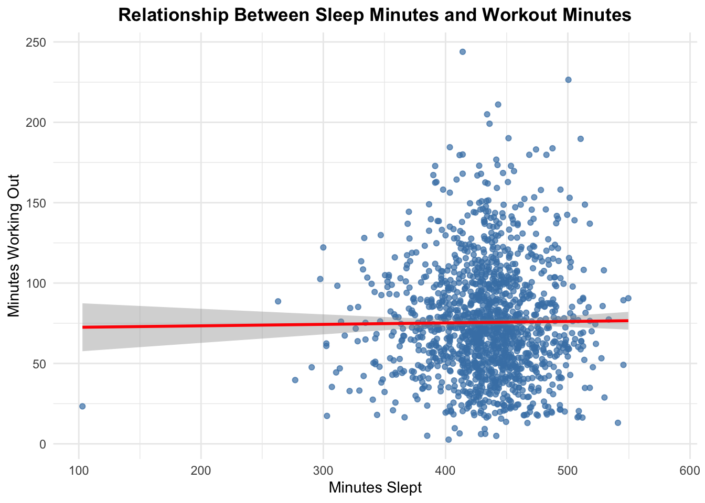
p = 0.6908

Slide 8
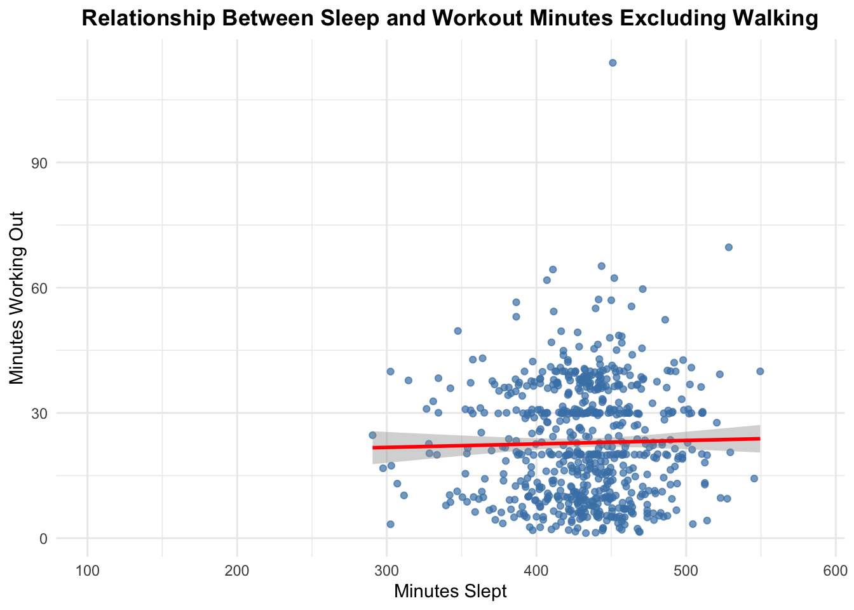
p = 0.5432

Slide 9
Conclusion & Future Directions
No significant relationship between physical activity and the amount of sleep measured
Study more participants, I am a robot!
Weekly trends vs daily?
Use more precise measurements of activity and sleep
Examine vitality

Slide 10
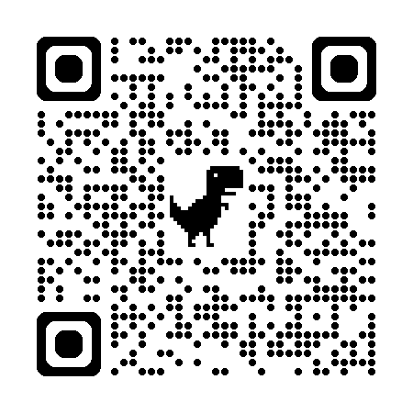
Questions?
Joe D'Agostino
joseph.d'agostino@stockton.edu
Github - joedag32

